Slide 1
Touch UI dialog introduction and Example

Slide 2
Introduction to Touch UI Dialog
Touch UI support was introduced by adobe in AEM 5.6.
AEM (5.6+) supports both classic UI & Touch UI. Default UI is set as Touch UI by adobe in AEM 5.6+ but it provides the options to users to switch classic UI as default.

Slide 3
Differences between Classic UI & Touch UI
Classic UI Dialog | Touch UI Dialog
Classic UI dialog is based on EXTJs | Touch UI dialog is based on Coral UI + Granite UI
Classic UI dialog is not responsive | Touch UI dialog is responsive & uses Mobile first approach
dialog is the root node | cq:dialog is the root node
Root node uses EXTJs xtypes | Root node uses Granite UI resource Types

Slide 4
Switch User Interface from Touch UI to Classic UI
There are 2 ways to switch from touch from Touch UI to classic UI.
1. AEM Site side
Go to Projects (http://localhost:4502/projects.html).
2. Configuration Manager.
WCM Authoring UI Mode Service.

Slide 5
How to convert classic UI to Touch UI dialog?
Download package from https://docs.adobe.com/docs/en/aem/6-2/develop/dev-tools/dialog-conversion.html
Open dialog conversion console http://<hostname>:<port-nr>/libs/cq/dialogconversion/content/console.html

Slide 6
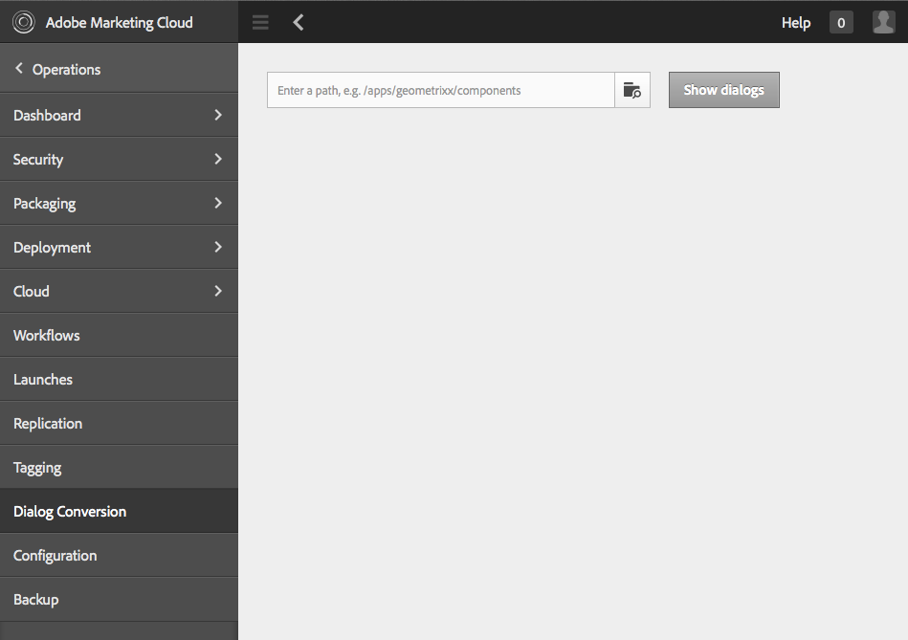
Conversion Console

Slide 7
What if my component does not have touch ui dialog?
If for any component, touch UI is not used then it will fallback to Classic UI.

Slide 8
Example

Slide 9
Thank You

